Slide 1

Orientation to Computing-I
L T P :2 0 0
www.lpu.in Lovely Professional University
‹#›

Slide 2

Delivery method
Lectures- 2
Tutorial- 0
Practical- 0
Credits- 2
www.lpu.in Lovely Professional University
‹#›

Slide 3
Course Outcomes
CO1 :: explore about the structure of computer and its various peripheral devices
CO2 :: recognize the significance of disk partitioning for the deployment of an operating system
CO3 :: describe the differentiation and usefulness of various shell commands
CO4 :: analyze different types of network topologies, network devices and functionalities of different servers
CO5 :: understand the basic concepts and terminologies about the security aspects associated with secure web browsing
CO6 :: practice technical concepts in various tools and create technical profiles on different computing platforms
www.lpu.in Lovely Professional University
‹#›

Slide 4
Program Outcomes
PO-1 Engineering knowledge::Apply the knowledge of mathematics, science, engineering fundamentals, and an engineering specialization to the solution of complex engineering problems.
PO-2 Problem analysis::Identify, formulate, research literature, and analyze complex engineering problems reaching substantiated conclusions using first principles of mathematics, natural sciences, and engineering sciences.
PO-3 Design/development of solutions::Design solutions for complex engineering problems and design system components or processes that meet the specified needs with appropriate consideration for the public health and safety, and the cultural, societal, and environmental considerations.
www.lpu.in Lovely Professional University
‹#›

Slide 5
Program outcomes
PO-6 The engineer and society::Apply reasoning informed by the contextual knowledge to assess societal, health, safety, legal and cultural issues and the consequent responsibilities relevant to the professional engineering practice.
PO-12 Life-long learning::Recognize the need for, and have the preparation and ability to engage in independent and life-long learning in the broadest context of technological change.
PO-13 Competitive Skills::Ability to compete in national and international technical events and building the competitive spirit
www.lpu.in Lovely Professional University
‹#›

Slide 6
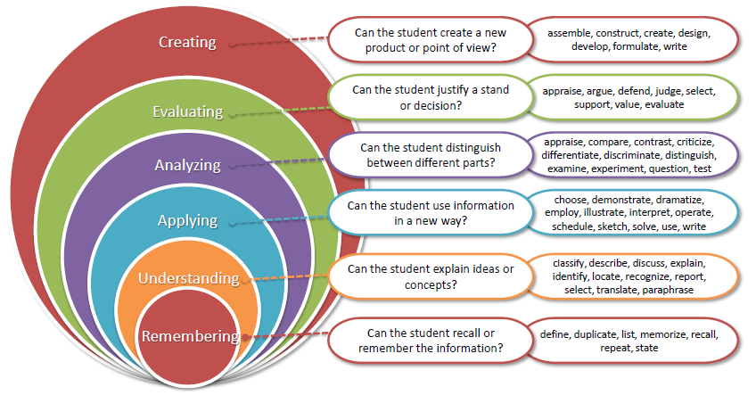
Bloom’s taxonomy
www.lpu.in Lovely Professional University
‹#›

Slide 7
Contents
Unit I
Computer Systems
Computer Languages
Unit II
Operating System
Linux Operating System
Unit III
File system management
Other Shell commands
Unit IV
Computer Network and Communication
Cloud Computing
Unit V
Security Essentials
Secure web-browsing
Unit VI
Version Control
MOOCs/Hackathons
www.lpu.in Lovely Professional University
‹#›

Slide 8
Why Orientation to Computing?
As a computer science student in their beginner stage you need to know how the various things in computer work and how the computer is used in multiple instances.
You need to understand the brief descriptions of subjects that will be further explored in future subjects through your degree programme
www.lpu.in Lovely Professional University
‹#›

Slide 9
Evaluation Criteria
3 CAs will be conducted throughout
Ca 1 & 2 will be MCQ
CA 3 will be Evaluation of student profiles
No MTE and ETE for this subject will be held
www.lpu.in Lovely Professional University
‹#›

Slide 10
Any Questions???
www.lpu.in Lovely Professional University
‹#›

